Slide 1
How to Write a Winning Book Proposal
Workshop by Badia Ahad, PhD

Slide 2
About Me
•Associate Professor of English at Loyola University Chicago
*Vice Provost for Faculty Affairs
•Author of two monographs and one edited collection
•Former Director of Training, Head Coach, Campus Workshop Facilitator with NCFDD

Slide 3
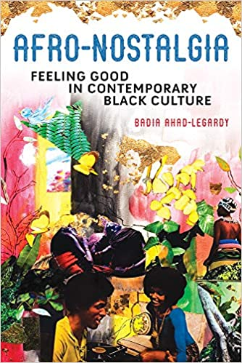
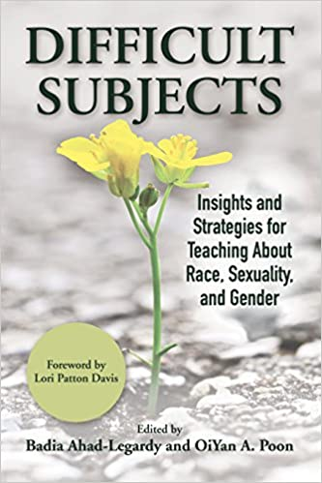
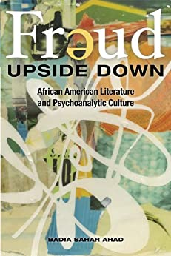

Slide 4
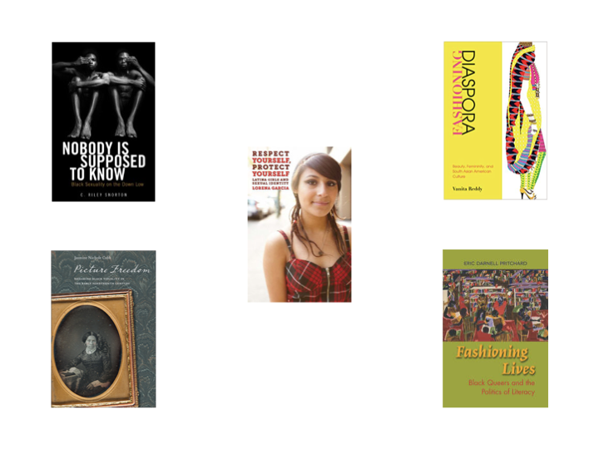

Slide 5
The Plan for the Day
Telling Your Story (*The Project Description)
Mapping Your Narrative (*The Chapter Outline)
Entering the Conversation (*The Market Analysis)
Next Steps (*Proposing Your Proposal; Selecting the “Right” Press)
Produce a draft or detailed outline of your book proposal

Slide 6
Why Write a Book Proposal
•BECAUSE YOU WANT TO PUBLISH WITH AN ACADEMIC PRESS
•BECAUSE YOU HAVE AN IDEA BUT YOU’RE NOT SURE IF IT’S A BOOK...YET
•BECAUSE YOU HAVE A COUPLE OF ARTICLES AND YOU WANT TO SEE IF YOU CAN DEVELOP A THROUGH-LINE FOR A FULL BOOK MANUSCRIPT

Slide 7
Why writing a book proposal is hard (*no matter how many times you’ve done it before)
•CHANCES ARE YOUR PROJECT IS INCOMPLETE OR
MAYBE IT IS STILL IN THE ”IDEA STAGE”
•THIS IS THE FIRST BIG PROJECT YOU’VE
WRITTEN WITHOUT A COMMITTEE/EASILY-ACCESSIBLE INTELLECTUAL COMMUNITY
•YOU’RE TRYING TO WRITE A DIFFERENT KIND
OF BOOK

Slide 8
How to Approach Today's Workshop
With an open mind
Without judgment
(Relatively) free from resistance ("inner critic," imposter syndrome, etc.)

Slide 9
PARTS OF THE PROPOSAL
CRITICAL CONTEXT/MARKET ANALYSIS
THE PROJECT DESCRIPTION
CHAPTER SUMMARIES
NUTS AND BOLTS
MS status, word count, images, permissions, etc.
An overview of the project and its significance
Overview of the book's chapters--the narrativee
A landscape of the conversation

Slide 10
THE PROJECT DESCRIPTION

Slide 11
The Project Description
Provides a detailed overview of your manuscript
Details why your project is important
Explains why your book should exist as a book (as opposed to a series of articles)
It tells a story
Address a problem/question
Fills a gap in an existing debate/conversation
Makes explicit the audience for the manuscript

Slide 12
The Project Description – Paragraph 1
Defining Significance examines the political significance of race by analyzing how the meaning of blackness influences the political agenda of urban black communities. [what the book is about]
How African-Americans understand and express their racial identity is as politically significant as the intensity with which they cling to it. Indeed, the assumption that African-Americans share a common identity has long been the basis for both political strategizing and political science theorizing. [why this is important]
This book analyzes the content of that identity, how it is constructed, and most importantly, what its consequences are for the ways that African-Americans apprehend and articulate their political interests and demands. [what the book discusses]
Drawing on two years of ethnographic research in Douglas and Grand Boulevard, a black neighborhood on Chicago’s south side, this work illustrates how community elites construct notions of racial authenticity and draw upon them to redefine conflict in ways that prioritize their interests. [evidence]

Slide 13
The Project Description - Paragraph 2
While questions about the political significance of race are long standing among social scientists, they have become particularly important in the post-segregation era, both in and out of the academy. [project significance]
Black politics scholars are questioning whether race remains politically dominant in the post-civil rights period, or has declined in significance relative to other social identities such as class and gender. [one side of debate]
Likewise, scholars of white public opinion are engaged in a parallel debate about the extent to which racism explains the preferences of whites on matters regarding racial policy. [another side of debate]
Both of these questions assume that the most important aspect of racial identity is the strength with which it is felt—rather than how it is defined or understood. [fault line in current conversation]
Thus traditional research relies upon reified concepts of race, and fails to consider the political implications of both the meaning of racial categories or the process of their construction. [fault line in current conversation]

Slide 14
The Project Description – Paragraph 3
Defining Significance offers a new approach to the question of the contemporary significance of race by examining how notions of blackness are defined, contested and used by African-Americans in political debate. [the INTERVENTION]
Using a social constructionist framework, it extends public and intellectual debates in the fields of political science and race politics by demonstrating how definitions and narratives of black authenticity are used to manage intra-racial conflict and redefine the black public agenda. [methodology]
In doing so, this work challenges and broadens existing conceptions of racial identity used by political scientists and offers an alternative framework for understanding its relevance to and impact on politics. [restate the INTERVENTION]

Slide 15
Let's Write!!!

Slide 16
Q1: What Question Will Your Book Address or Resolve?
EXAMPLE: WHY HAS THE CONCEPT OF NOSTALGIA BEEN OVERLOOKED IN THE FIELDS OF AFRICAN AMERICAN AND MEMORY STUDIES?

Slide 17
Q2: What is already known about your topic? What is the “accepted knowledge?” (i.e. race is socially constructed)

Slide 18
Q3: Why is your position on this matter important? How does your position make us think differently? What new knowledge do you bring to the subject?
WHY SHOULD READERS PAY ATTENTION TO WHAT YOU HAVE TO SAY ABOUT THIS ISSUE?

Slide 19
Q5: Who is the intended audience for this book? Be specific…and broad thinking.
EXPLAIN WHY YOUR AUDIENCE(S) WILL FIND IT VALUABLE.

Slide 20
MAPPING YOUR NARRATIVE:
THE CHAPTER SUMMARIES

Slide 21
CHAPTER SUMMARIES
OFFERS AN OVERVIEW OF THE EVIDENCE USED TO SUPPORT THAT
ARGUMENT
MAKES EXPLICIT THE
PURPOSE OR ARGUMENT OF THE CHAPTER
ESTABLISHES A THROUGH-LINE FOR THE BOOK
MORE THAN A SUMMARY

Slide 22
Chapter Summary – EXAMPLES
Recognizing the influence of the political history I chart in chapter one on early U.S. literary and political culture, this chapter links the anti-Catholic anxieties evident in early national novels such as Charles Brockden Brown’s Wieland (1798), James Fenimore Cooper’s The Pioneers (1823), and Catharine Maria Sedgwick’s Hope Leslie (1827) to Federalist-era debates about the relationship between a nation’s territorial scope and its capacity to protect the individual liberties
of politically and religiously diverse citizens.
If chapter three focuses on how Catholicism brings to light the pressures produced by representative government within the liberal democratic state, then this fourth chapter shows how renderings of Catholicism allowed mid-century writers to imagine solutions to the lingering problem of female citizenship. Specifically, the chapter argues that in novels such as Hawthorne’s The Marble Faun (1860) and Augusta Evans’s Inez: A Tale of the Alamo (1854), “Catholic” spaces such as Mexico and Italy serve as imaginary sites on which the problem of female citizenship—that is, citizenship without legal, public representation—can be tested.
This final chapter extends the argument of the penultimate chapter to show that by the end of the nineteenth century Catholicism came to represent not a threat to nor the limit of liberal democracy but rather the corruptions inherent within liberal democracy itself. Taking as its focus Adams’s novel Democracy and Twain’s A Connecticut Yankee in King Arthur’s Court, the anti-Catholicism of which has been long recognized but little remarked upon, this chapter shows that Adams’s and Twain’s self-conscious caricatures of the Catholic Church allow them to represent the corrupt and imperial impulses of the liberal state as affronts to democracy and freedom.

Slide 23
YOUR TURN

Slide 24
TELLING THE STORY
CHAPTER 1: [WRITE BRIEF 2-3 SENTENCE SUMMARY
HERE]
CHAPTER 3 IS SIMILAR
TO/DIFFERENT FROM/BUILDS UPON CHAPTER 1
AND/OR 2 IN THE FOLLOWING WAY(S): WRITE 1-2 SENTENCES
CHAPTER 4 IS SIMILAR
TO/DIFFERENT FROM/BUILDS UPON CHAPTER 1,
2, AND/OR 3 IN THE FOLLOWING WAY(S): WRITE 1-2
SENTENCES
CHAPTER 2 IS SIMILAR
TO/DIFFERENT FROM/BUILDS UPON CHAPTER 1 IN
THE FOLLOWING WAY(S): WRITE 1-2 SENTENCES

Slide 25
THE CRITICAL CONTEXT/
MARKET ANALYSIS

Slide 26
Market Analysis/Overview of
Competing and Complementary Texts
What books is your primary audience reading/talking about/buying?
What books explore the same issue(s) as your book?
How does your book differ or build upon the ideas in these texts?
**NO EDITORIALIZING**

Slide 27
Market Analysis – EXAMPLE #1
Difficult Subjects lies at the intersection of two critical dialogues: the first is what Piya Chatterjee and Sunaina Maira refer to as the “imperial university” and the other focuses on the challenges of teaching from a social justice framework in the context of the “imperial” university. Along with The Imperial University: Academic Repression and Scholarly Dissent (University of Minnesota Press, 2014), other scholars have contributed incisive critiques of the burgeoning culture of neoliberal conservatism in higher education, specifically, Henry Giroux’s Neoliberalism’s War on Higher Education (Haymarket Books, 2014), Sara Ahmed’s On Being Included: Racism and Diversity in Institutional Life (Duke University Press, 2012), and Roderick Ferguson’s The Reorder of Things: The University and its Pedagogies of Minority Difference (University of Minnesota Press, 2012). These recent texts offer a clear picture of how colleges and universities actively create a climate of intolerance despite touting the virtues of “diversity and inclusion.”

Slide 28
Market Analysis – EXAMPLE #1 (para. 3)
While the essays featured in Difficult Subjects participate in the aforementioned conversations, the volume itself is distinguished from these texts in the following ways: 1) The scope of Difficult Subjects extends beyond a single focus on one particular aspect of identity (e.g. race or gender)—while teaching in these areas is addressed in our edited volume, the essays also address, for example, the importance of privileging emotions as a form of knowledge particularly when discussing sensitive subjects in the classroom; 2) Each chapter in Difficult Subjects focuses on a distinct problem or unresolved question, while at the same time offering practical strategies that other faculty can use immediately in their own classrooms; 3) This project is timely in that it would be, upon publication, one of the first to address how university and college classrooms might both address and harness the energy of student activism and resistance emerging on campuses throughout the country. As Claudia Rankine has written, “The state of emergency is also always a state of emergence.” While teaching the “difficult subjects” has posed numerous challenges for faculty and students attempting to push back against corporate agendas, there has also been a resurgence of interest among faculty and students to bring these conversations about race, class, gender, sexuality, and the intersection of them, to the classroom. As such, this volume would be among the first to address the problematics and, more importantly, the successes of radical social justice teaching within an increasing corporatized culture in higher education and an intensified moment of radical student and social activism.

Slide 29
YOUR TURN :-)
Notes:
Move to paper example of Project Description

Slide 30
SKETCH YOUR OWN MARKET ANALYSIS
STEP ONE
STEP TWO
STEP THREE
What books represent the critical landscape, broadly speaking? List them.
How do they represent the conversation you are entering?
Explain your intervention.

Slide 31
5 MINUTE BREAK

Slide 32
THE NUTS AND BOLTS

Slide 33
THE NUTS AND BOLTS
WHAT IS THE CURRENT STAGE OF THE MANUSCRIPT?
WILL YOUR BOOK HAVE ANY PHOTOGRAPHS OR ILLUSTRATIONS? IF
SO, DO YOU HAVE PERMISSIONS IN PLACE?
WHEN WILL YOUR BOOK BE COMPLETE, IF IT IS NOT COMPLETE
ALREADY?
HOW MANY WORDS DO YOU ANTICIPATE THE MANUSCRIPT WILL BE?

Slide 34
NEXT STEPS:
SELECTING THE RIGHT PRESS AND
PROPOSING YOUR PROPOSAL

Slide 35
NEXT STEPS:
SELECTING THE RIGHT PRESS AND
PROPOSING YOUR PROPOSAL
PUBLICATION TIME
QUALITY OF PEER REVIEWS, RELATIONSHIP WITH
EDITORS, TIMING
WHAT PRESSES PUBLISH BOOKS IN YOUR FIELD?

Slide 36
To Query or Not to Query?
A QUERY EMAIL IS A TWO-PARAGRAPH NOTE SENT TO ACQUISITION EDITORS IN AN EFFORT TO GAUGE THEIR INTEREST IN YOUR BOOK MANUSCRIPT.
THIS IS A NOTE…IT IS NOT YOUR PROPOSAL. MAKE CERTAIN YOUR QUERY IS SHORT AND TO THE POINT.

Slide 37
How to Write A Query
Introduce yourself
Overview of your project (1-2 sentences)
Explain the intervention (1-2 sentences)
Describe why the project is a good fit for the Press/series
Follow-up with offer to send proposal and/or sample chapter(s)

Slide 38
Where Do YOU Go From Here?
FINISH YOUR PROPOSAL
WRITE YOUR QUERY
GET SOME ACCOUNTABILITY

Slide 39
QUESTIONS?

